Slide 1

Machine Learning – Certification Program (Aug 2018)
Code Assignment – Module 3
Phone : +91 9999658436
Offices : Bengaluru, New Delhi
Email : contact@cellstrat.com
Web : www.cellstrat.com
CellStrat™ Confidential. All Rights Reserved.

Slide 2
Module 3 (Set 2 code)
Techniques of Machine Learning

Slide 3
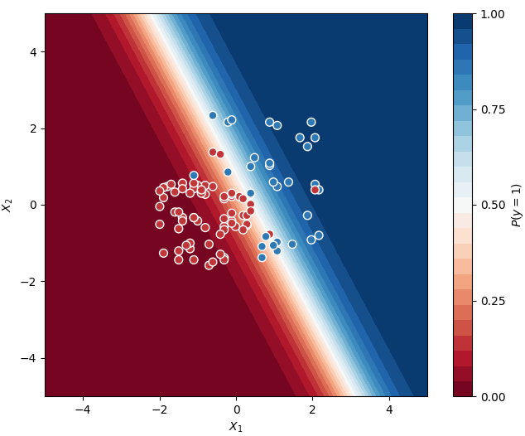

Tutorial
Module 3 - Classification-LogisticRegression.ipynb
Tutorial name :- Predict whether consumers will buy houses or not, given their age and salary.
Exercise –
Q1 - What issues do you see in the plot which is produced by this code ? How to solve these issues ?
Q2 – What is the meaning of fit and predict ?
Q3 – How many true positives do you see in the classifier result in the original program provided to you ? What is meant by true positive and true negatives ?
Q4 – What is the purpose of StandardScaler class ?

Slide 4
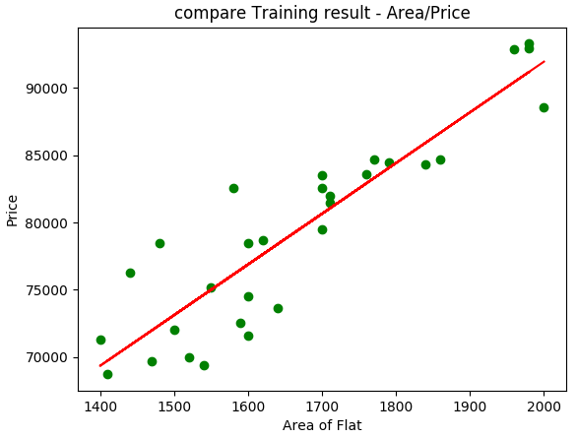
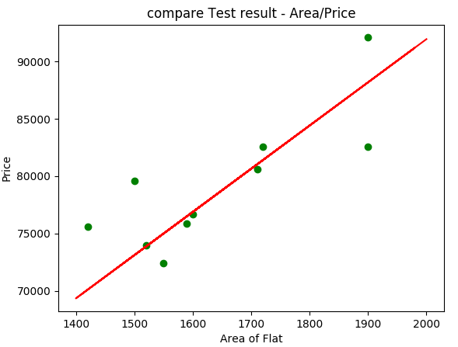
Tutorial
Module 3 - Regression-LinearRegression.ipynb
Tutorial name – Predict house prices based on area of the house
Exercise –
Q1 - Is the trained model accurate and why ?
Q2 - What is the approximate price of the house for houses with area (give approx. values)
1700
1900

Slide 5
Tutorial
Module 3 - Regression-PolynomialRegression.ipynb
Tutorial name – Insurance Premium Calculation based on age
Exercise –
Q1 – For this dataset of insurance premium calculation, which is a better model Linear Regression or Polynomial Regression and why ?
Q2 – Try Polynomial regression with 2,3,4, 10 degree polynomials and interpret the results. Which one is best for this dataset provided ?
Q3 – For degree 3 polynomial regression, what is the predicted insurance premium for ages 29, 45, 53 and 80 ?

